Slide 1
Computing the
Quadrillionth Digit of π
A Supercomputer in the Garage
Ed.Karrels@gmail.com

Slide 2
Overview
Computing a few digits of π
Implementing in CUDA
Performance results
Production challenges

Slide 3
Breaking the Record
Old record (2010): 2 quadrillionth bit (2*10¹⁵)
  Yahoo Hadoop 1000 node cluster, 23 days
  4-GPU CUDA box, 24 days
4 quadrillionth bit
  37 days on one 4-GPU box
8 quadrillionth bit
  26 days on 26 boxes, 30 GPUs

Slide 4
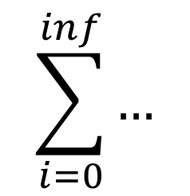
Computing π
Irrational (digits don’t repeat)
Transcendental (infinite-length formula)
  Usually an infinite sum
$$\sum_{i=0}^{inf}{…}$$

Slide 5
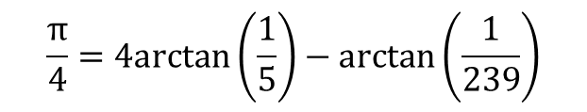
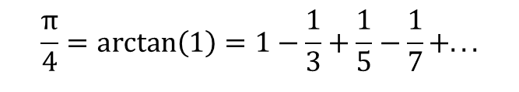

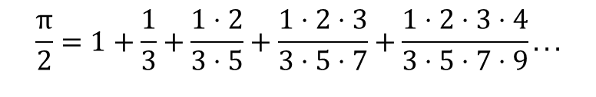

Sample π formulas
$$\frac{π}{2}=1+\frac{1}{3}+\frac{1⋅2}{3⋅5}+\frac{1⋅2⋅3}{3⋅5⋅7}+\frac{1⋅2⋅3⋅4}{3⋅5⋅7⋅9}...$$
$$arctan\left(\frac{1}{x}\right)=\frac{1}{x}−\frac{1}{3x^{3}}+\frac{1}{5x^{5}}−\frac{1}{7x^{7}}+...$$
$$\frac{π}{4}=arctan\left(1\right)=1−\frac{1}{3}+\frac{1}{5}−\frac{1}{7}+...$$
$$\frac{π}{4}=4arctan\left(\frac{1}{5}\right)−arctan\left(\frac{1}{239}\right)$$
Chudnovsky
$$\frac{1}{π}=12\sum_{k=0}^{inf}{\frac{{\left(−1\right)}^{k}\left(6k\right)!\left(13591409+545140134k\right)}{\left(3k\right)!{k!}^{3}{640320}^{\left(3k+3/2\right)}}}$$

Slide 6
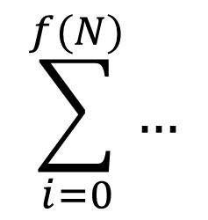
Computing the first N digits of π
i=0 3.13333333333333333
i=1 0.00808913308913309
i=2 0.00016492392411510
i=3 0.00000506722085386
i=4 0.00000018789290094
i=5 0.00000000776775122
...
Sum: 3.141592653228088
$$\sum_{i=0}^{f(N)}{…}$$
Compute each term to N digits
Iterate until terms are small enough (< 10^{-N})
  Chudnovsky formula: ~13 digits per iteration
  Limiting factor: disk speed (assuming fast multiply)

Slide 7
Computing the N^{th} digit of π
10^7 * 3.141592653589793238462643383…
= 31415926.53589793238462643383…
…drop the integer part…
.53589793238462643383…
Scale the calculation by 10^{N}
Drop everything left of the decimal
Want the billionth digit?
  Simply (!) multiply by 10^{1,000,000,000}
Must be an easier way…

Slide 8
Dropping upper digits
What’s the last digit of 1234567 * 9876543?
  Only need the last digits of the factors: 7 and 3
  (7 * 3) = 21
  (7 * 3) % 10 = 1
  (a*b)%m == ((a%m) * (b%m)) % m
If result will be modulo-m, do the modulo beforehand

Slide 9
Computing large powers
32
16
4
1
3⁵³
  53 = 1 1 0 1 0 1₂
  3⁵³ = 3³² * 3¹⁶ * 3⁴ * 3¹
  X^{n} in O(log n)
  3⁵³ % m = [(3³² % m)*(3¹⁶ % m)*(3⁴ % m)*(3¹ % m)] % m
(X^{n}) % m very efficient
  “Modular exponentiation”
  Modulo m at each step to keep numbers small
  Heavily used in crypto

Slide 10
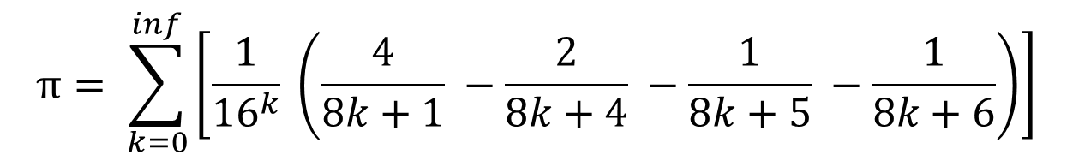
Bailey-Borwein-Plouffe Formula
$$π= \sum_{k=0}^{inf}{\left[\frac{1}{{16}^{k}} \left(\frac{4}{8k+1} −\frac{2}{8k+4} −\frac{1}{8k+5} −\frac{1}{8k+6}\right)\right]}$$
Important!
Infinite sum (like most π formulas)
Each term multiplied by 16^{k}
What if we want the N^{th} digit?

Slide 11
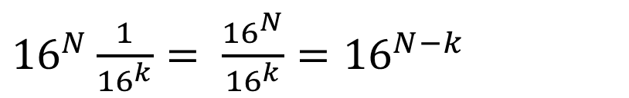
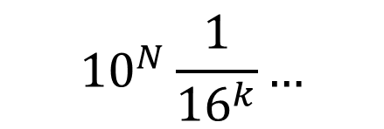
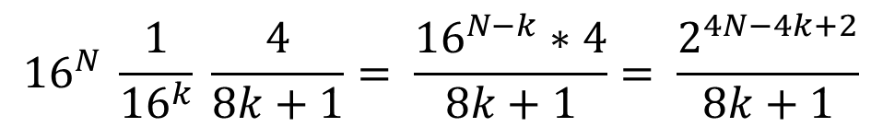
Nth digit, BBP formula
$${10}^{N}\frac{1}{{16}^{k}}…$$
Not very interesting
How about base 16?
${16}^{N}\frac{1}{{16}^{k}}= \frac{{16}^{N}}{{16}^{k}}={16}^{N−k}$
Much more interesting…
One term of BBP:
$${16}^{N} \frac{1}{{16}^{k}} \frac{4}{8k+1}= \frac{{16}^{N−k}∗4}{8k+1}= \frac{2^{4N−4k+2}}{8k+1}$$

Slide 12
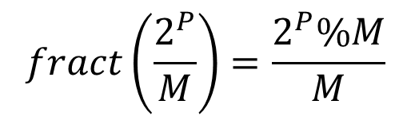
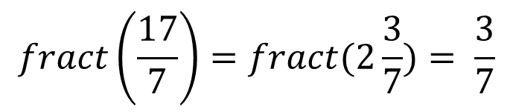
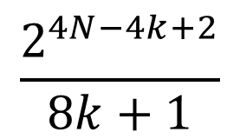
Use modulo to drop integer part
$$\frac{2^{4N−4k+2}}{8k+1}$$
$$fract\left(\frac{17}{7}\right)=fract(2\frac{3}{7})= \frac{3}{7}$$
That looks familiar!
$$fract\left(\frac{2^{P}}{M}\right)=\frac{2^{P}\%M}{M}$$

Slide 13
Main loop
sum = 0;
END = …function of target digit…
for (k = 0; k < END; k++) {
P = …function of k…
M = …function of k…
t = modpow(2, P, M);
sum += t / M;
}
75% of the runtime
24% of the runtime
Each term is independent
Combine results with simple summation

Slide 14
CUDA Implementation
Embarrassingly parallel
Very little data movement
Hard part: 128-bit and 192-bit integer types
  64-bit modpow: need 128-bit when squaring
  Division: 192bit / 64 bit → 128 bit
    Start with estimate, Newton-Raphson to refine
  Multiprecision arithmetic: need the carry bit
  Lots of inline PTX assembly

Slide 15
Optimizations
Upgrade from NVCC from 4 to 5: 3x
Bellard formula: +40%
Montgomery Reduction: 7x

Slide 16
Bellard formula
$$π=\frac{1}{64} \sum_{k=0}^{inf}{\left[\frac{{(−1)}^{k}}{{1024}^{k}} \left(\frac{256}{10k+1} −\frac{64}{10k+3}−\frac{4}{10k+5}−\frac{4}{10k+7}+\frac{1}{10k+9}−\frac{32}{4k+1}+\frac{1}{4k+3}\right)\right]}$$
16 → 1024
4 bits → 10 bits
All odd denominators
2^{P} % M much easier if M is odd
Montgomery Reduction: use 2⁻¹ mod M, change modular base from M to a power of 2
Modulo power of 2: bitwise ‘and’
Bonus: alternating sign minimizes round-off error

Slide 17
Performance
O(N log D) time, O(D) space
  N=which digit, D=length of result
Time to compute 100 millionth digit:
  GPU (GTX 680): 1.57 seconds
  CPU (3.4GHz i5): 211 seconds
    Using GNU GMP math library for large integers
Not a fair comparison
  CPU code is a single thread, not vectorized, not hand-optimized

Slide 18
Performance
Better comparison: Yahoo Hadoop cluster
Time to compute 500 trillionth hex digit:
  Me: one 4-GPU machine
    24 days
    Hardware costs: $5000
  Yahoo: 1000 8-core machines
    23 days
    Hardware costs: $500,000-ish?

Slide 19
Production Issues
Heat
Task allocation
Accuracy?
Unplanned downtime
Planned downtime

Slide 20
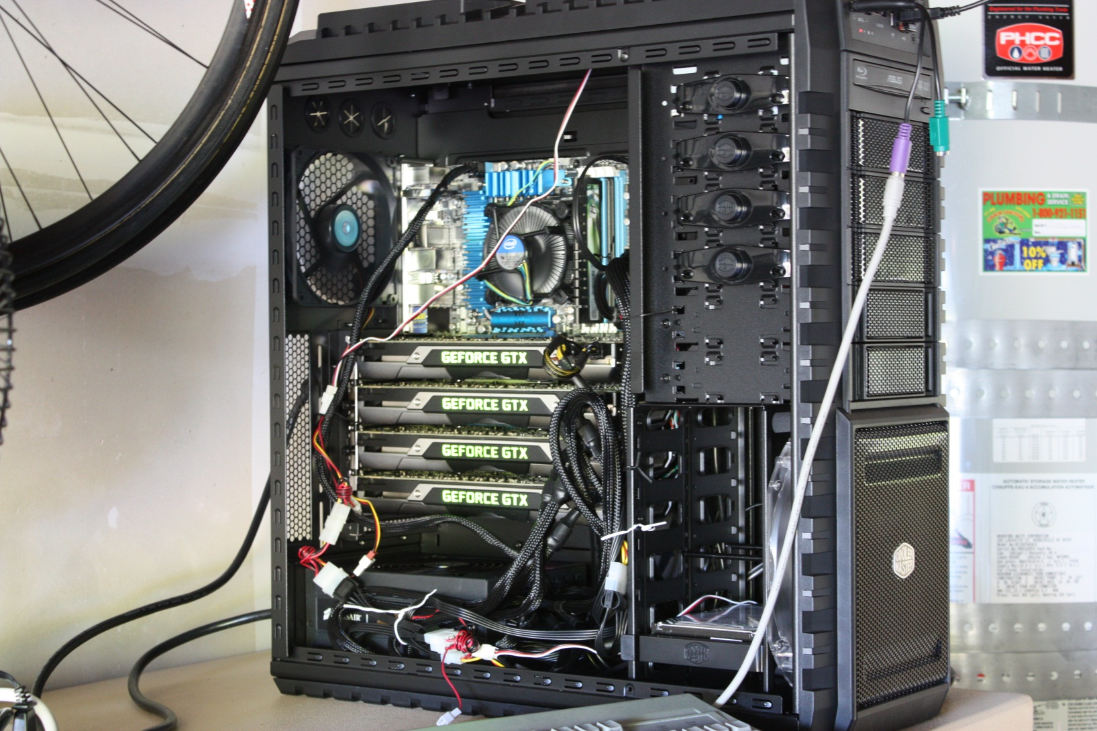
Homebuilt Box, 4xGTX 690

Slide 21
1100 Watt Space Heater

Slide 22
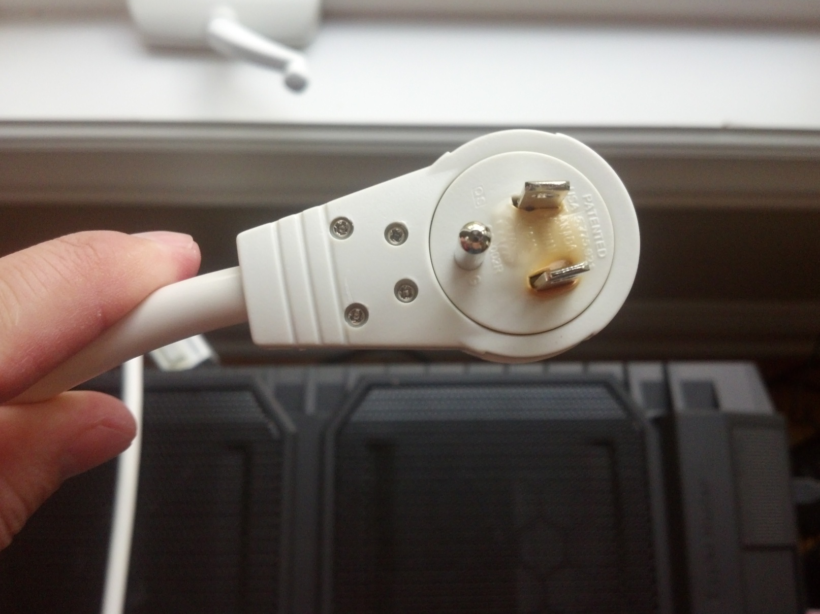
1800 Watt Power Strip

Slide 23
Accuracy
How do I know the results are correct?
  Shorter runs: check other results online
    Bellard: up to 2.7T
    Yahoo: up to 500T
  Longer runs: run again, with offset
10¹⁵-7: 1C23D488 353CB3F7 F0C9ACCF A8262A4B
10¹⁵+1: 353CB3F7 F0C9ACCF A9AA215F 2556D630

Slide 24
Task Allocation
Simple master/slave
Each task ~1 minute long
  Subrange of the main iteration loop
Log per-task results

Slide 25
Per-task Checks
Iterations: 246,646,000,000,000..246,647,000,000,000
digit: 1,999,999,999,999,999
client: linux60821
result: 0x1d57ca87472261f0d8735613bebd5721
digit: 2,000,000,000,000,007
client: linux60812
result: 0x472261f0d8735613bebd15d037d6a42b
0x1d57ca87472261f0d8735613bebd5721
0x472261f0d8735613bebd15d037d6a42b8
Each task result can be double-checked
On mismatch, just re-do two tasks

Slide 26
Hardware Errors?
Over 50 days of GPU time
  4 GTX 690 (Kepler) cards: zero errors
  2 GTX 680 (Kepler) cards: zero errors
  24 GTX 570 (Fermi) cards:
    16 cards: zero errors
    4 cards: 1-4 errors
    4 cards: 7-10 errors
All errors were irreproducible
All consumer-level cards: non-ECC memory

Slide 27
Guerilla Supercomputing
Running at night on school lab machines
Single-GPU machines
Causes jittery display if user logged in
User logs in? Hide.
  Detect GUI login → idle the GPU

Slide 28
Useful Results
Never need more than 38 digits of π
Hardware stress-test
  GTX 690: A+
  GTX 570: B
  Belkin power strip: F
Reusable library
  Multi-word integer library
  Modular exponentiation

Slide 29
Next Steps
More distant digits!
Digits of π²
Other hardware / programming models
  AMD, Intel MIC, BOINC
Titan time?
Looking for a good Ph.D. program…
  Ed.karrels@gmail.com

